Slide 1
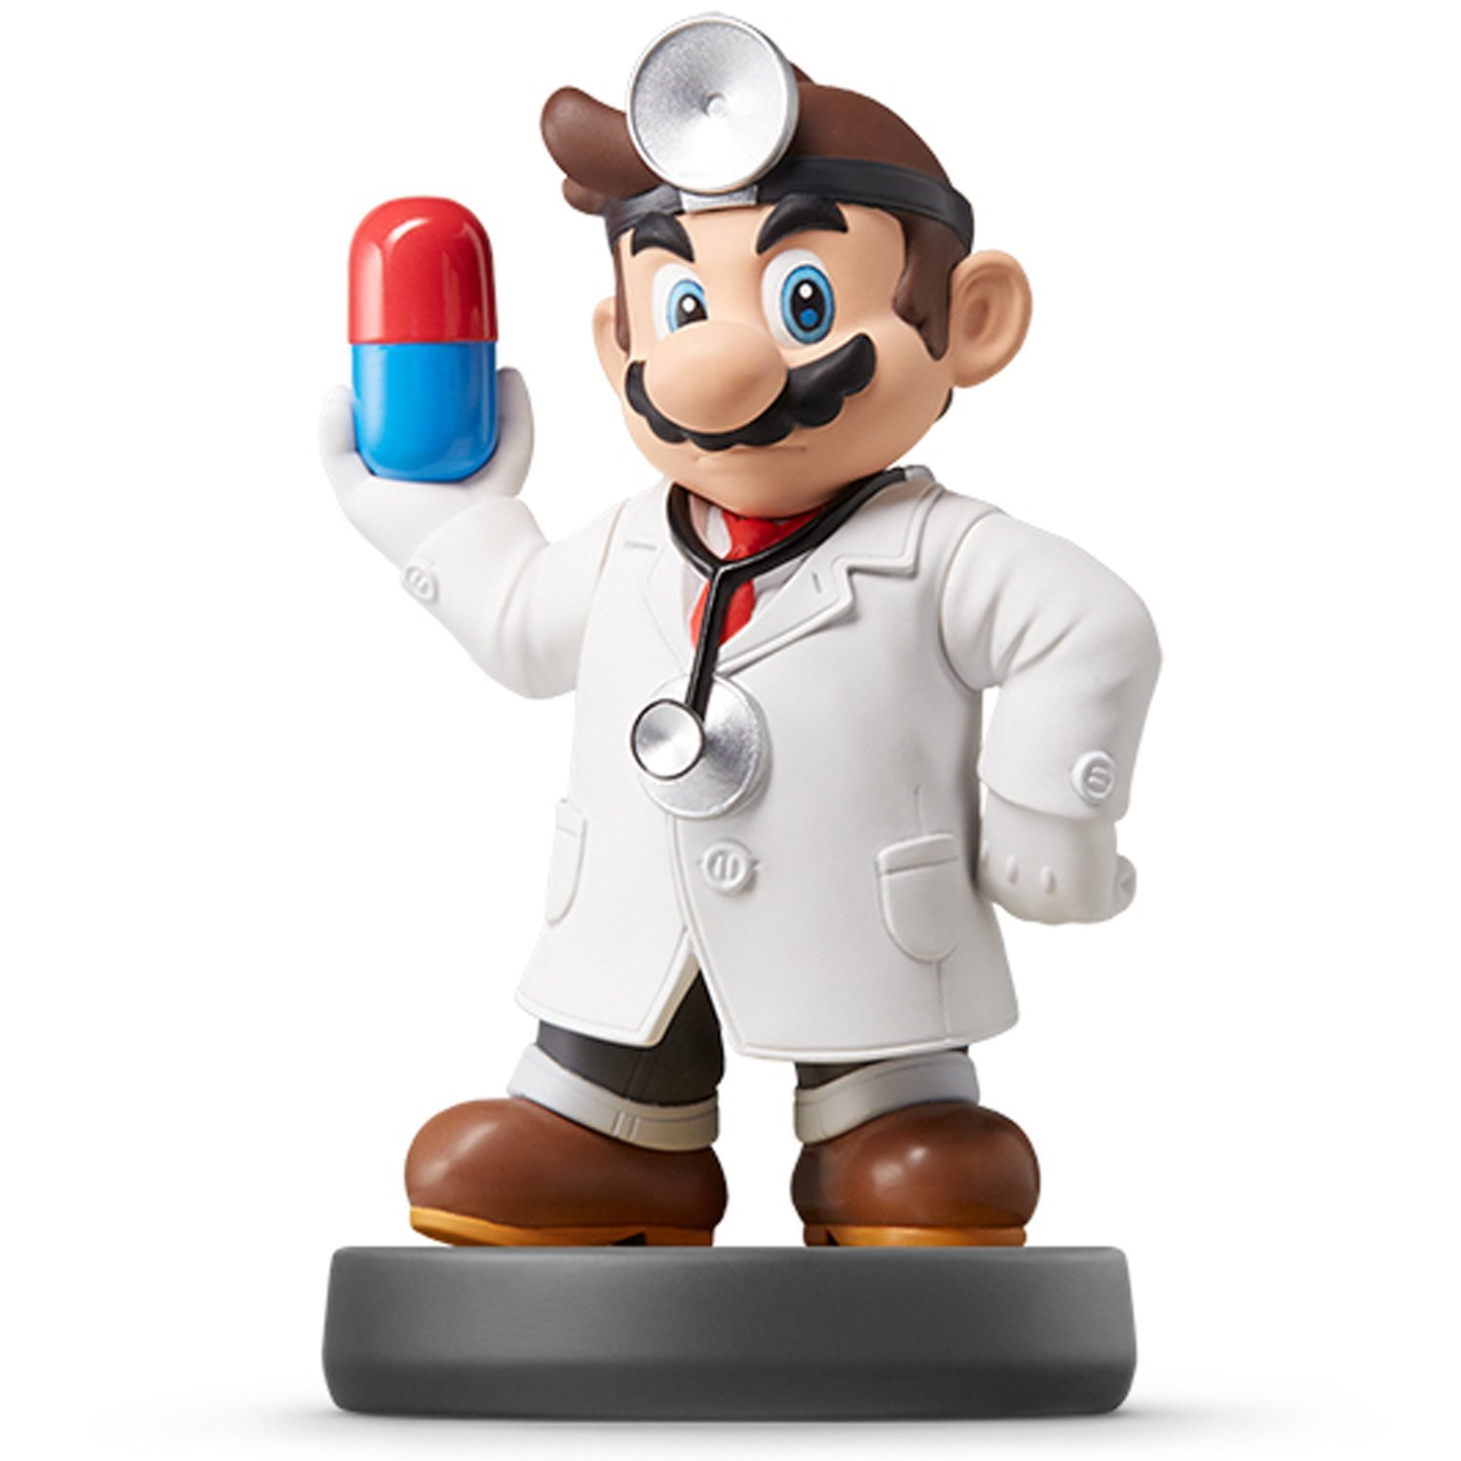
Data Visualization

Slide 2
Who are you?
I Still Don’t Know
Fill-out : Form

Slide 3
Why are We Here?
To Develop a Personal and Intimate Hate/Love Relationship With R
To Install Some Key R Packages
Tidyverse
Rmarkdown
To Practice Coding via R Scripts
To Learn Elements of ggplot2
To Practice Making Visually Stunning Pictures that Change Lives

Slide 4
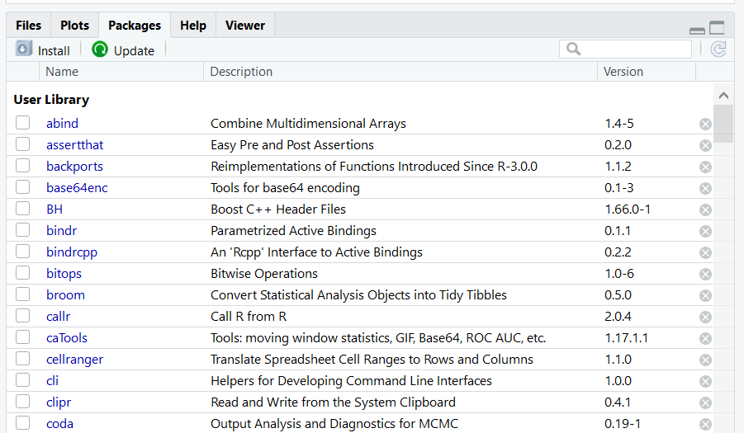
Initial Steps in RStudio
Install Tidyverse Package
Other Packages To Be Installed
RColorBrewer
RMarkdown
Select Install and Search on CRAN
install.packages(“tidyverse”)

Slide 5
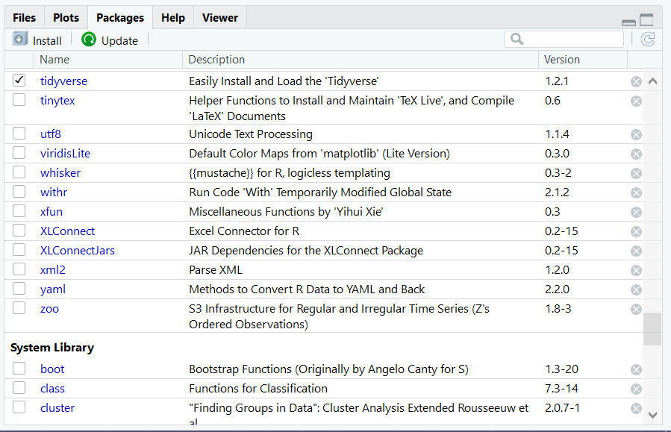
Initial Steps in RStudio
To Use the Package
Code
Check Box for Tidyverse
> library(“tidyverse”)

Slide 6
Closing?
Disperse and Make Reasonable Decisions

